Slide 1
Mobility aware and energy-efficient federated deep reinforcement learning assisted resource allocation for 5G-RAN slicing
Computer Communications - Jan 2024
Yaser Azimi, Saleh Yousefi, Hashem Kalbkhani, Thomas Kunz
Presenter- Divya K.

Slide 2
Abstract
Allocation of power and radio block (RB) resources in a multi-RAN scenario
Users of both rate-based and resource-based slices are considered
Mobility-aware and energy-efficient federated deep reinforcement learning-assisted resources allocation (ME-FDRL-RA) solutions are proposed
Deep learning models considered:
Stacked and bidirectional long-short-term memory (SBiLSTM)
Allocate resources to slices on a large timescale
Federated advantage actor-critic (F-A2C) allocates resources to a small time-scale
For RA, iterative algorithm – Interference-aware and energy-efficient power allocation (IA-EPA)
MF-FDRL-RA: Parameters – convergence speed, computational complexity, energy efficiency, number of accepted users
Challenges – User mobility, maintaining degree of inter-slice isolation

Slide 3
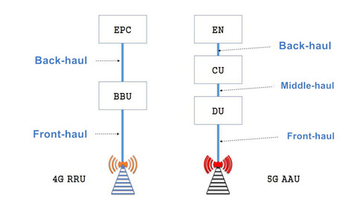
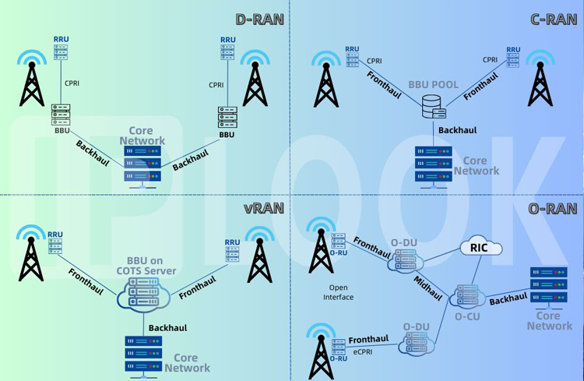
Introduction
Distributed architecture – RRUs + Dus + CU
Architectures proposed –
D-RAN
C-RA
O-RAN
F-RAN
v-RAN

Slide 4
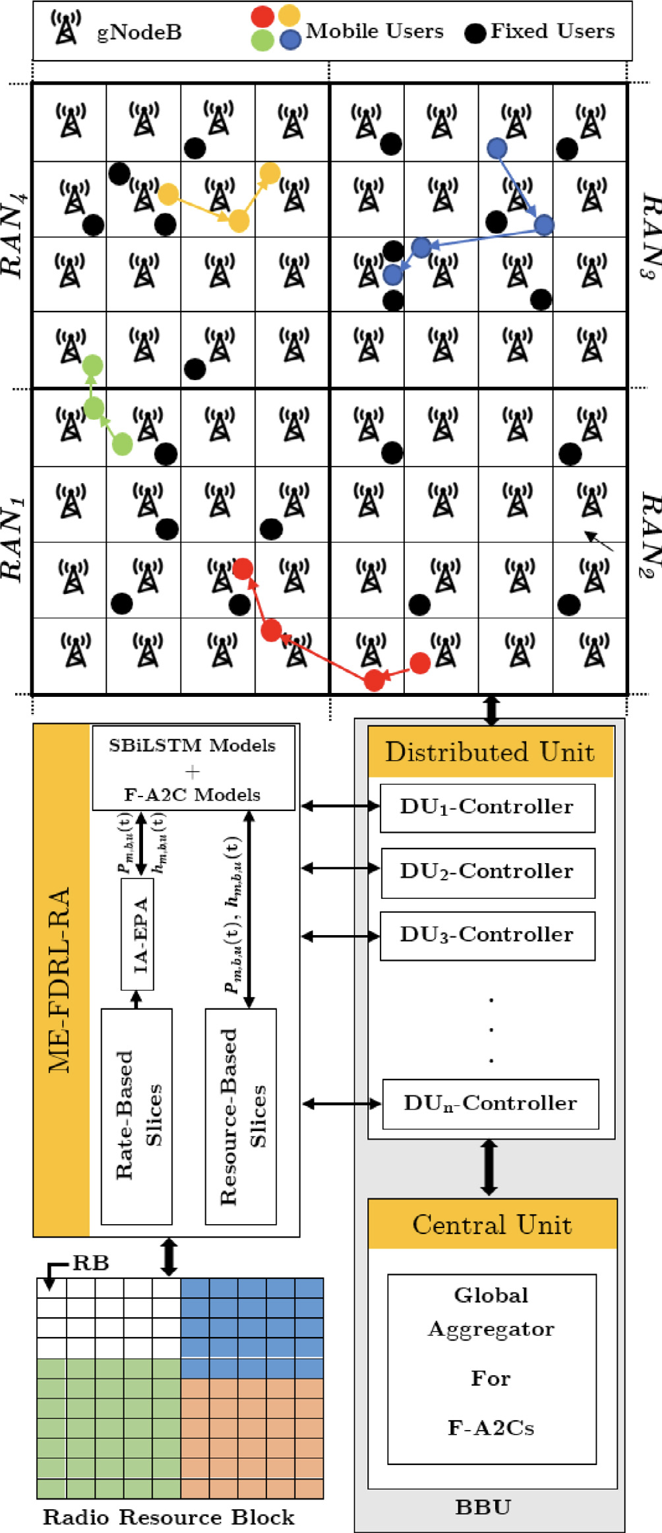
System Model
Assumptions – RANs have identical no.of slices and computational resources
Distributed RAN with O-RAN architecture where DU and CU are centralized in BBU
DU responsible for running RA algorithms
DU controllers communicate via orchestrator layer
CU runs aggregator using obtained data from agents to increase convergence speed

Slide 5

System Model
Fixed users and mobile users
Mobile users' movement model based on SWIM
Weight of destination cell C from home cell A –

Slide 6
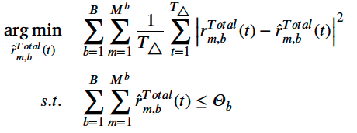
Problem definition and formulation of RA
Problem 1 – Resource Slicing with Mobility Awareness on a Large Time-Scale
Mobile and fixed users’ traffic – predict required resources for next PW
Meet QoS requirements
Minimize the error - MSE

Slide 7

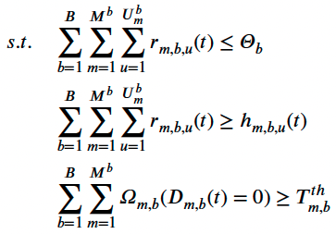

Problem definition and formulation of RA
Problem 2 – Resource Allocation to Users Per Slice on a Small Time-Scale
Online resource allocation
Control unpredicted traffic changes on large time-scale
Difference between amount of allocated resources before and after resource reconfiguration per slice –
Problem formulated -

Slide 8
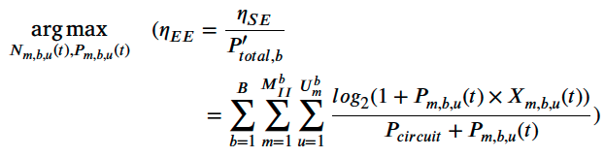
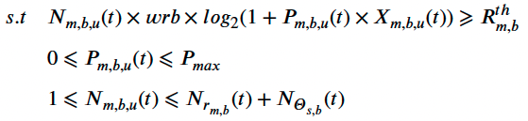
Problem definition and formulation of RA
Problem 3 – Determining the Required Resources for Users of Slices
Users’ resources in rate-based slice
Increase energy efficiency, spectrum efficiency, improve QoS of users
Considering channel conditions such as inter-RAN interference and user mobility

Slide 9
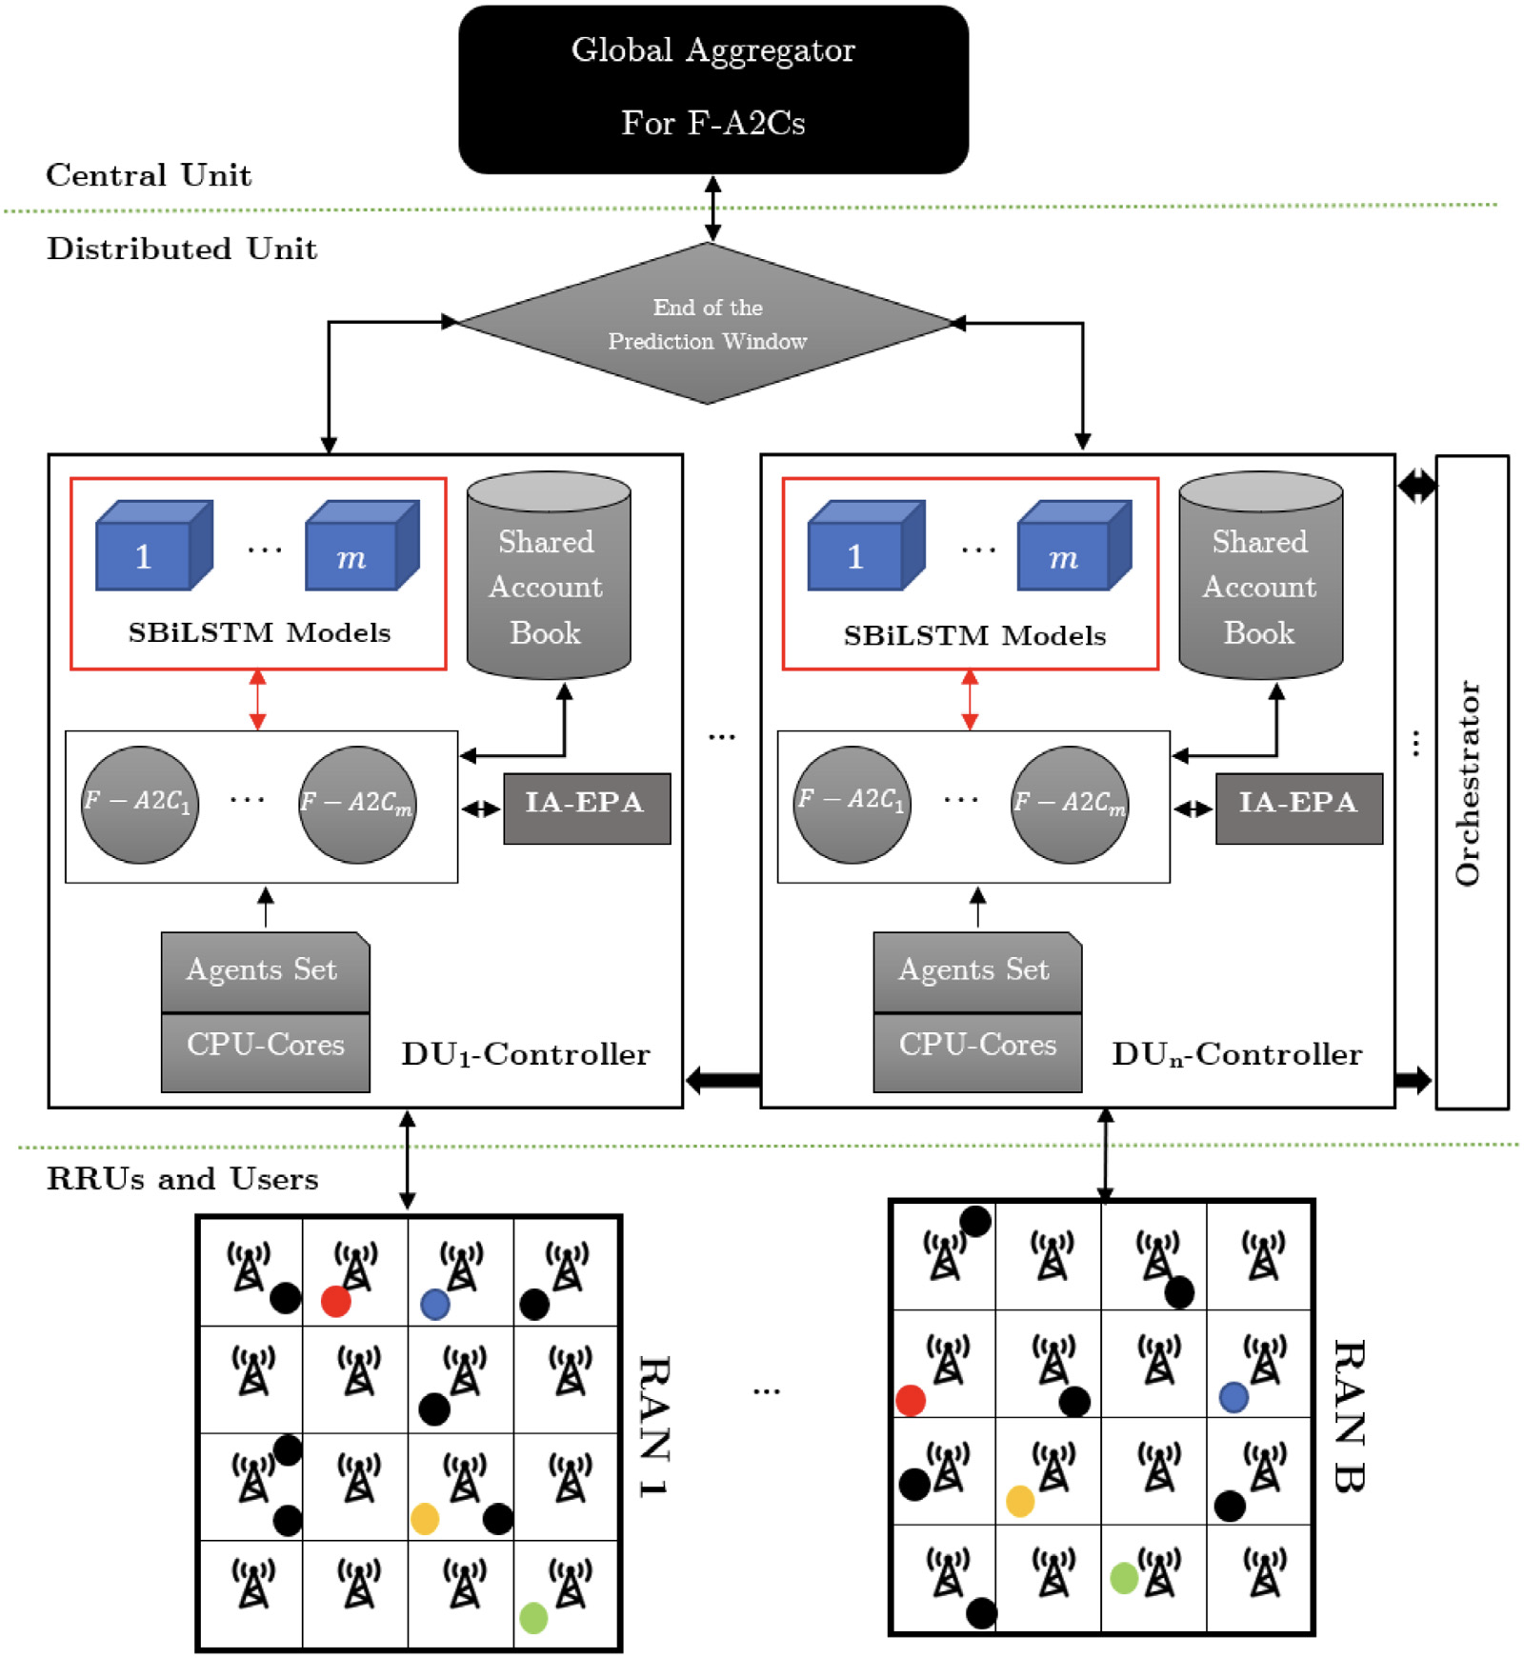
Proposed Solutions
ME-FDRL-RA components –

Slide 10
Proposed Solutions
ME-FDRL-RA components –
DU-Controllers: Runs DRL, SBiLSTM, IA-EPA algorithms, assigns power and radio resources
Orchestrator: exchange information (CSI and user Mobility)
Parallel F-A2Cs for set of slices per RAN: each RAN slice represents an F-A2c agent
Shared account book for each RAN: each RAN shares info related to current PW and previous PW to estimate allocated resources for next PW
IA-EPA method: iterative method to find optimal answer by considering the channel conditions and energy efficiency
SBiLSTM model for each slice in each RAN: to guarantee isolation among slices
Global Aggregator for F-A2Cs: to increase the convergence speed and improve F-A2C agents' decisions

Slide 11
Proposed Solutions
Large time-scale prediction
Track total traffic of fixed and mobile users in each time step
Sum of required resources for fixed users and mobile users of slice m in RAN b – input data for the prediction of allocated resources in slice m of Ran b in next PW
Confidence intervals, sample mean, and standard deviation of predicted values is calculated
Dynamically tuned during simulation
Upper bound for confidence interval is applied

Slide 12
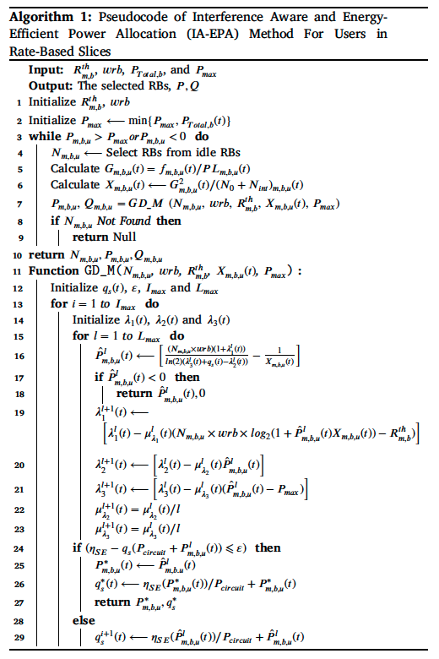
Proposed Solutions
Interference Aware and Energy-efficient Power Allocation (IA-EPA)
Gradient-descent-based sub-optimal method
Trade-off between the achievable rate and power consumption while considering interference caused by other transmitters
2 subproblems –
Minimum no.of idle RB
Minimum amount of power to maximize energy efficiency

Slide 13

Proposed Solutions
Samll time-scale prediction
Uses F-A2C for RA on small time-scale for each slice
Model –
Each slice makes the decision on RA
Accept/Reject new user is independent to other slices

Slide 14
Proposed Solutions
Scalability Assessment and Signaling Overhead
Each RAN is managed by a DU
Each DU-Controller executes RA algorithm, includes F-A2C agents, IE-EPA methods, SBiLSTM models for each RAN
Each Slice has 2 F-A2C agent, IA-EPA method, SBiLSTM model
Deployment scenarios:
Case 1 – Single system/multiple threads
Case 2 – Multiple systems/multiple threads
Case 3 – single system/single thread

Slide 15
Simulation results
Multi-Ran: 4 RANs
Slice m of RAN b arrival and departure rates: 𝜆[𝑚, 𝑏] and 𝜇[𝑚, 𝑏].
Requests assigned by FIFO policy
Fixed total number of users for mobility model
In F-A2C, rejection penalty is twice as isolation violation penalty
10 slices of RAN: 4 – resource-based, 6 – rate-based
FDRL uses 4 agents
Simulation includes 48000 time steps, PW – 1200 time steps
Each RAN has 200 users

Slide 16
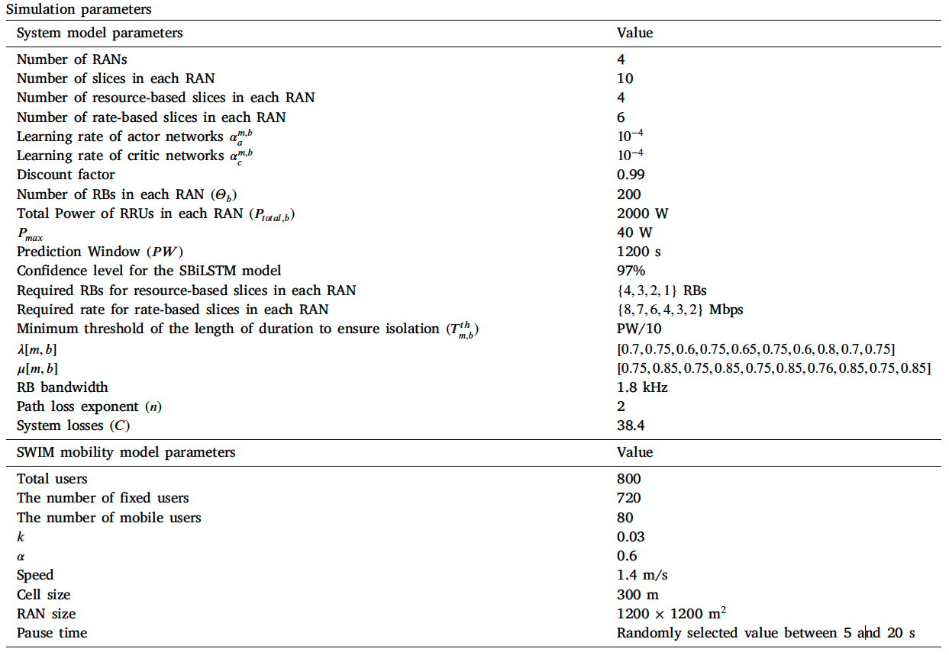
Simulation results

Slide 17
Simulation results
Competitive methods –
Extended EE-DRL-RA
Extended iRSS
E-FDRL-RA
ME-DRL-RA
Static Method

Slide 18
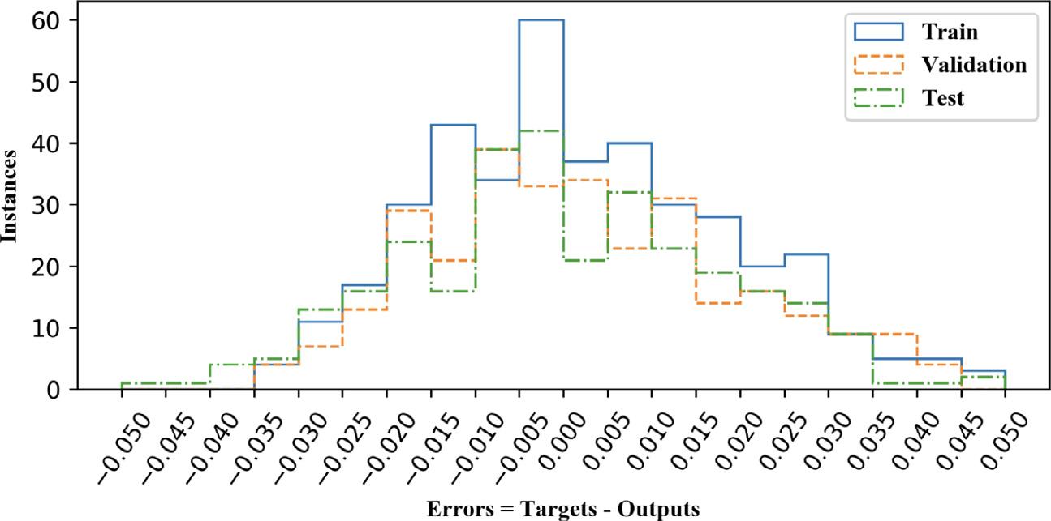
Simulation results
Traffic prediction accuracy for SBiLSTM model on a large time-scale

Slide 19
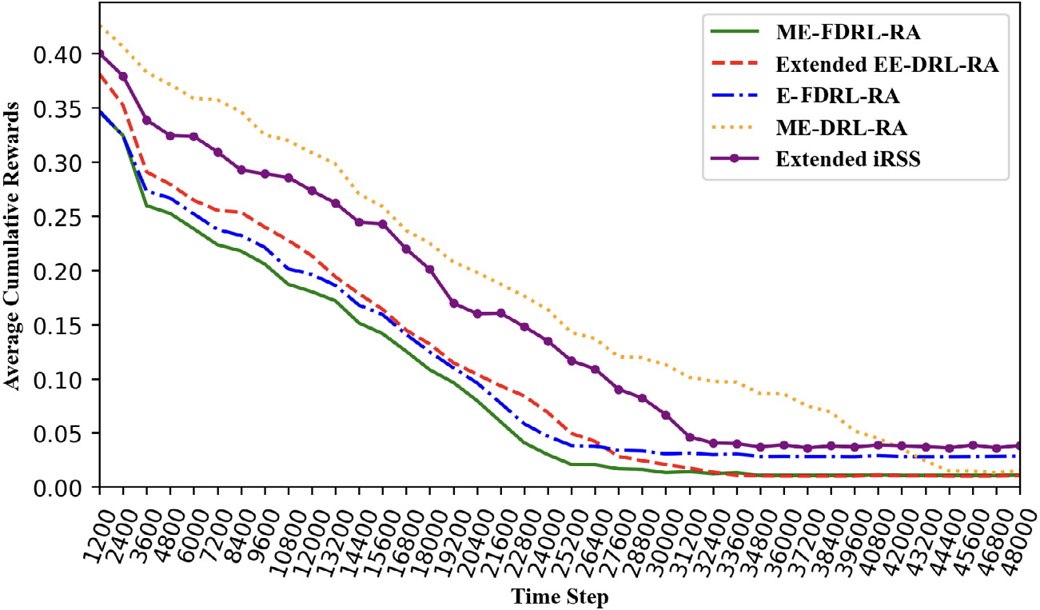
Simulation results
Convergence speed for the compared methods in the multi-RAN scenario.

Slide 20
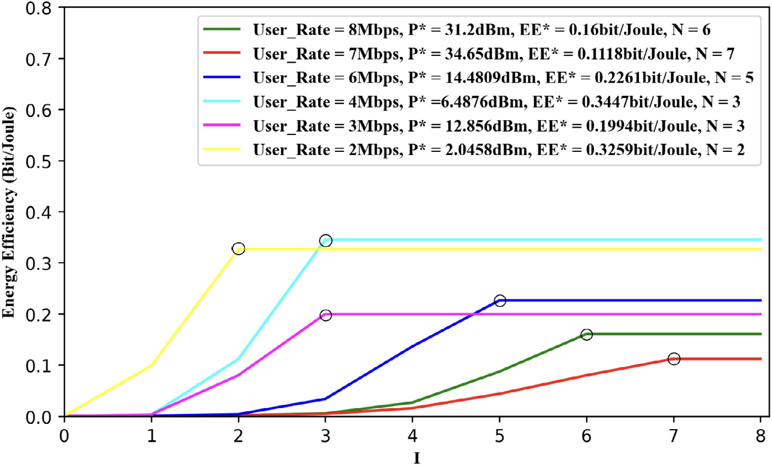
Simulation results
Energy efficiency versus number of iterations with different transmission rates in IA-EPA method.

Slide 21
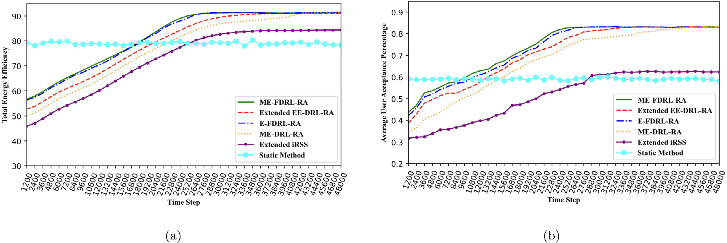
Simulation results
(a) Total energy efficiency (b) Average user acceptance percentage

Slide 22
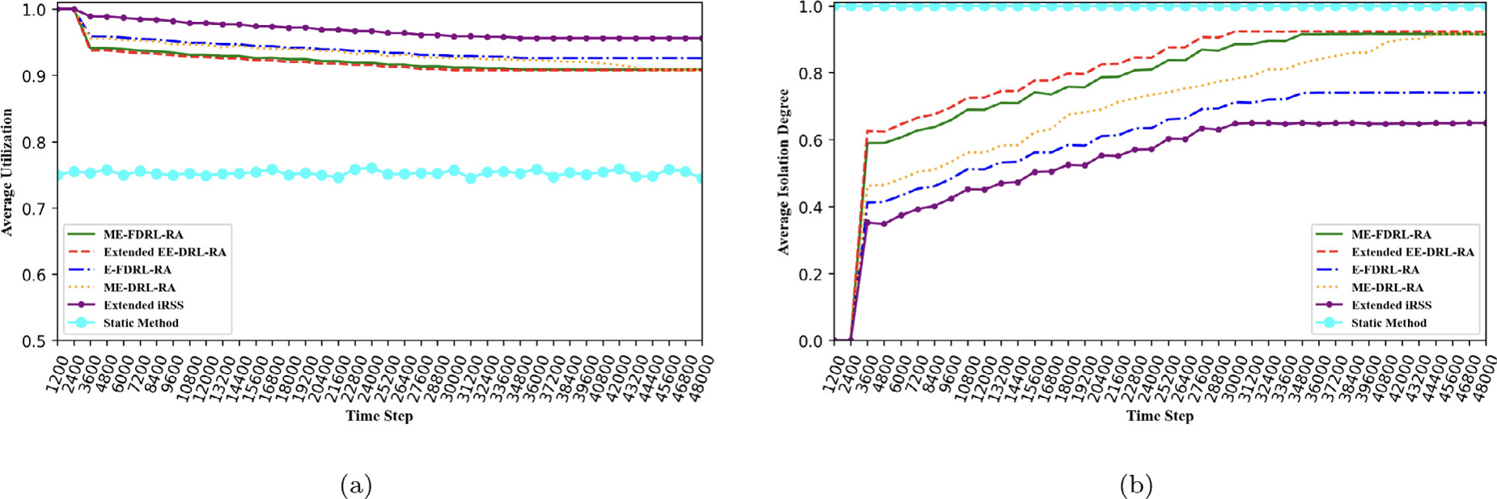
Simulation results
(a) Utilization of slices (b) Isolation degree among slices

Slide 23
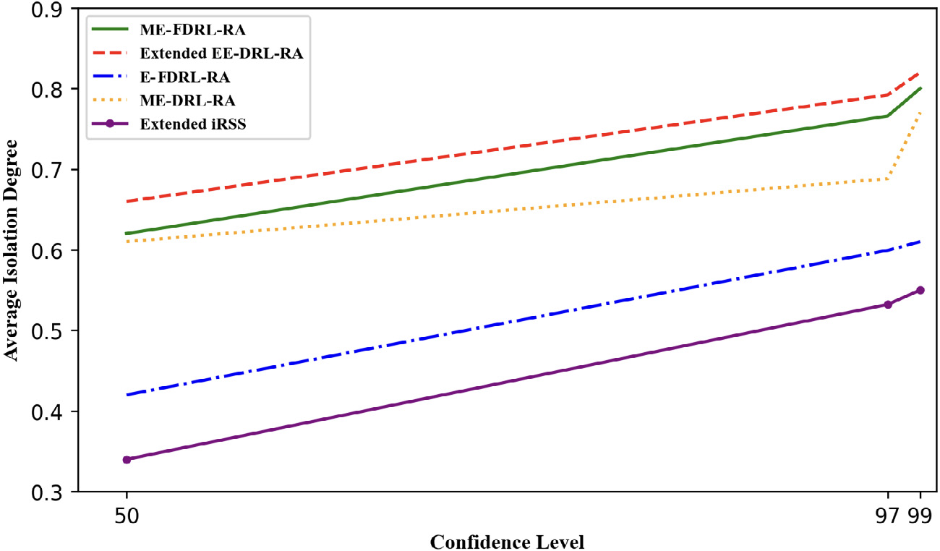
Simulation results
The effect of confidence level on isolation degree in a large time-scale.

Slide 24
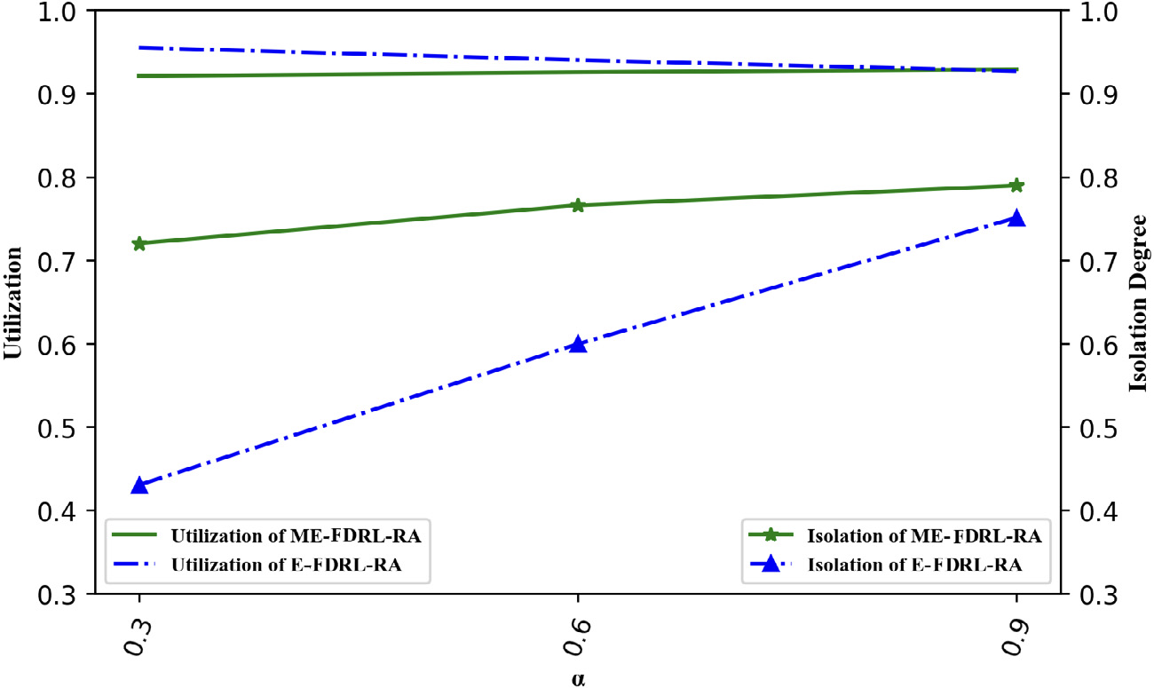
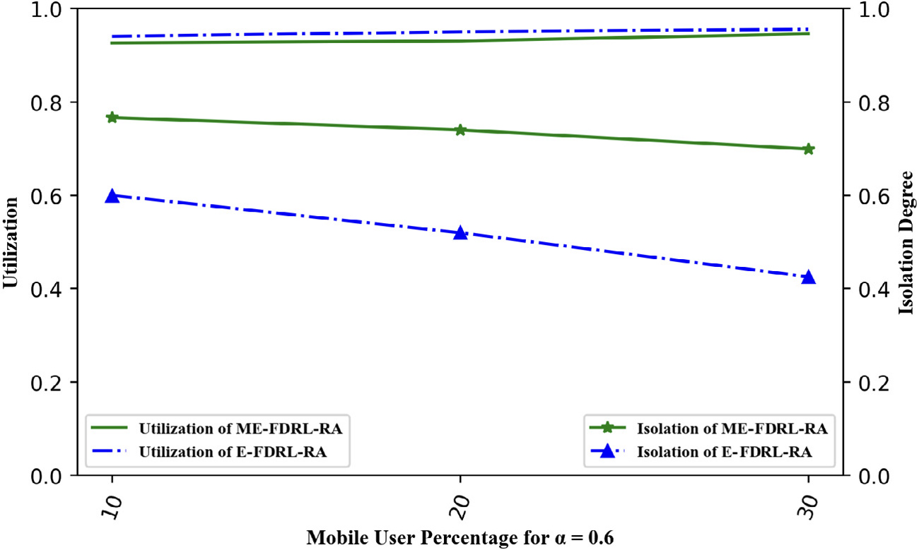
Simulation results
The effect of SWIM mobility degree in ME-FDRL-RA.
The effect of the number of human mobile users in ME-FDRL-RA

